Slide 1
Pseudomonas Syringae: Micro-organisms as ice makers
Lola Bardel, Izabella Pomykalska, Ananda Wolz, Timothy Mann, Thomas Cañellas Rey De Vinas

Slide 2
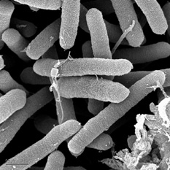

Introduction
What is Ice Nucleation?
Pseudomonas Syringae:
Its characteristics :
Gram negative
Plant pathogen
Rod shaped
What makes Pseudomonas Syringae so incredible?

Slide 3
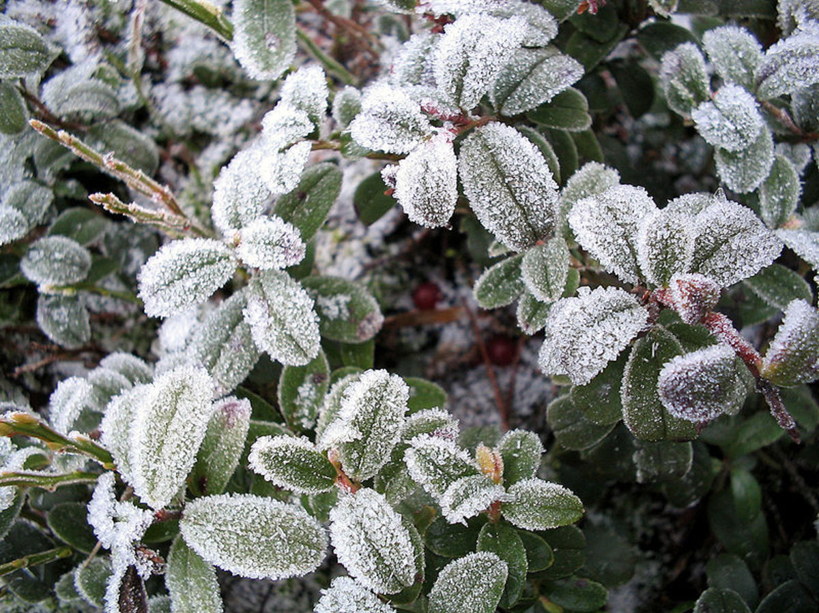
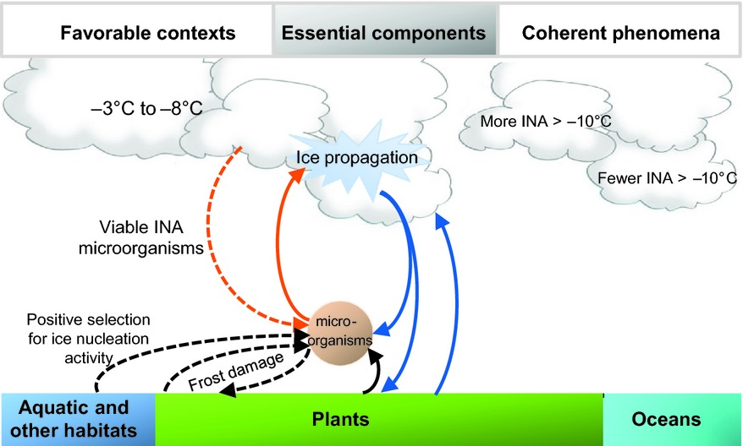
The evolutionary advantage of ice nucleation
Staffan Enbom, CC BY 2.0, via Wikimedia Commons
Colonization of intracellular space (endophytic phase)
Specie propagation via hydrological events (epiphytic phase)
Source : https://doi.org/10.1111/gcb.12447
Notes:
Lola [1’30]

Slide 4
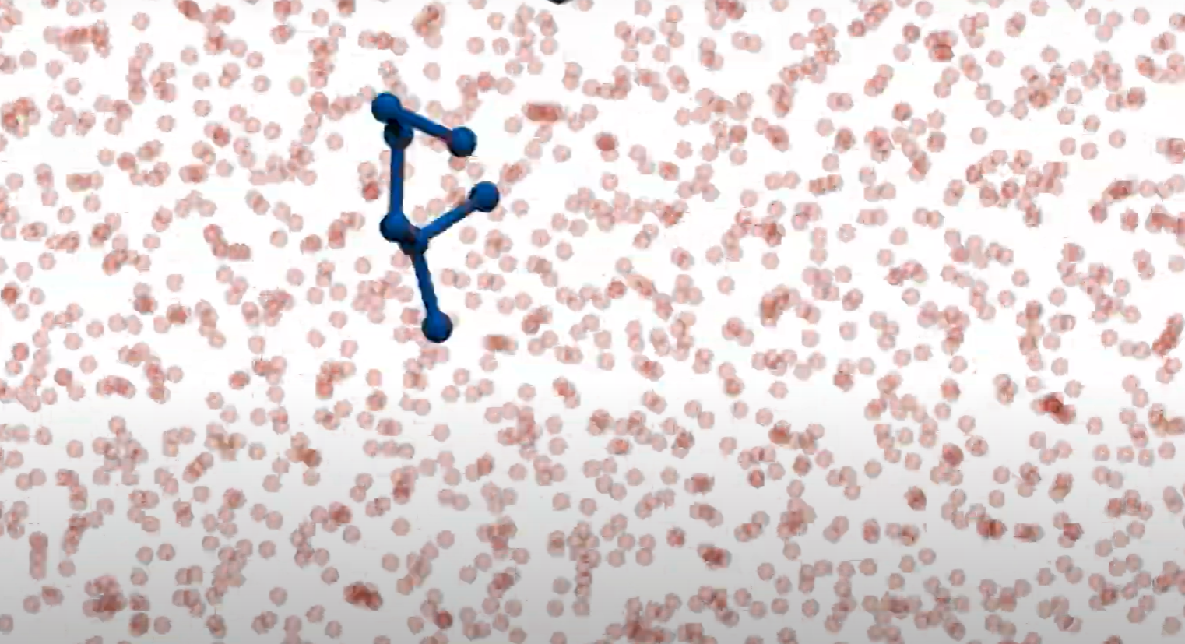
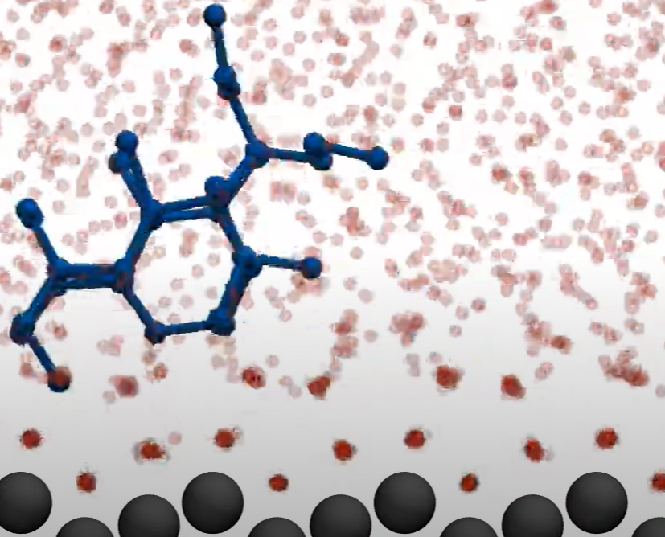
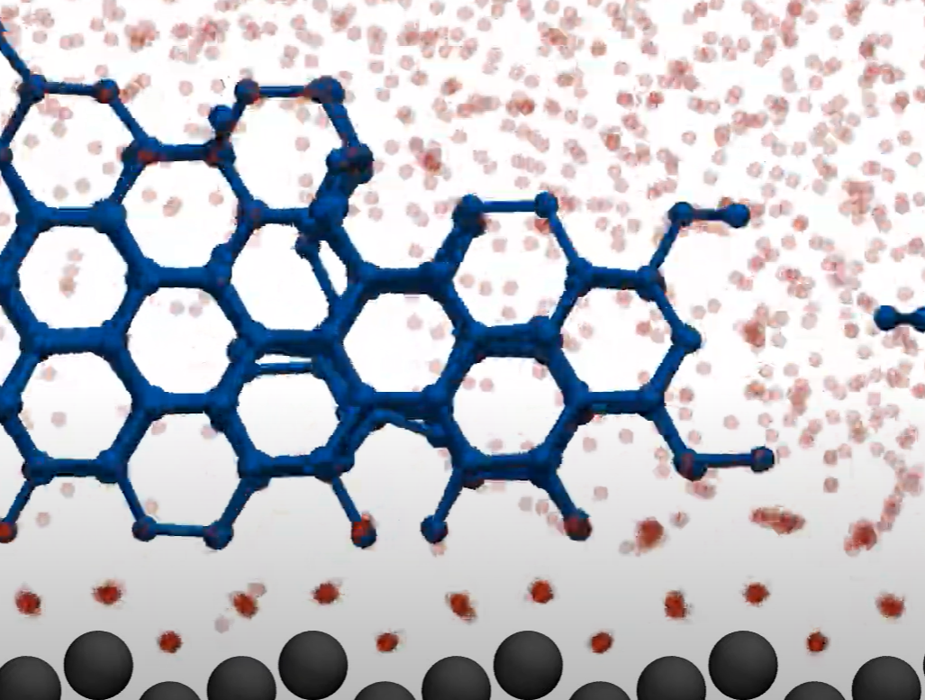
Ice Nucleation
Pure Water: Presence of substances, cluster formation Critical size of cluster → Ice clusters too small to grow facilitated, fluctuation dynamics → growth more likely
→ attachment & detachment
Nucleation = initial process that occurs in the formation of a crystal from a liquid or a vapour
Homogeneous Nucleation → pure water
Heterogeneous Nucleation → foreign materials (like Pseudomonas syringae) in contact with water
https://www.youtube.com/watch?v=hKT_SGK2qtY
(Youtube: The Many Faces of Heterogeneous Ie Nucleation, icelcn)

Slide 5
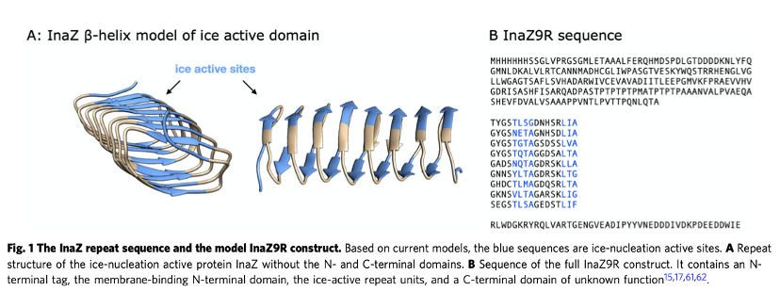
How does the bacteria perform ice nucleation?
=> Thanks to INPs (Ice Nucleating Proteins)
Ice nucleation activity at -14°C to -2°C
Located mainly at the outer-membrane
Associated with phospholipids PI
Possibly 2-3 monomers associate to form active ice nuclei
(Roeters et al., 2021)
Notes:
Iza

Slide 6
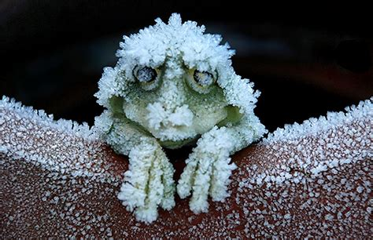
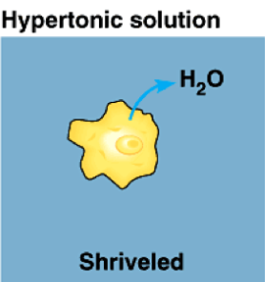
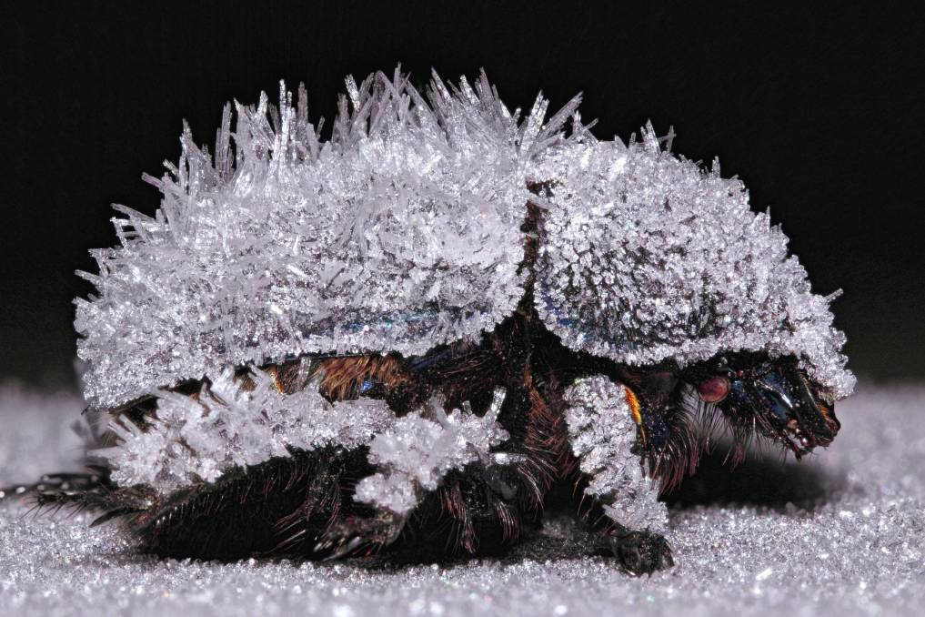
Examples of symbiosis
Mutualism
Vertebrates & Insects
Osmotic stress & cryoinjury
Inoculative freezing & hemolymph freezing point
Parasitism
Supercooling limitation

Slide 7

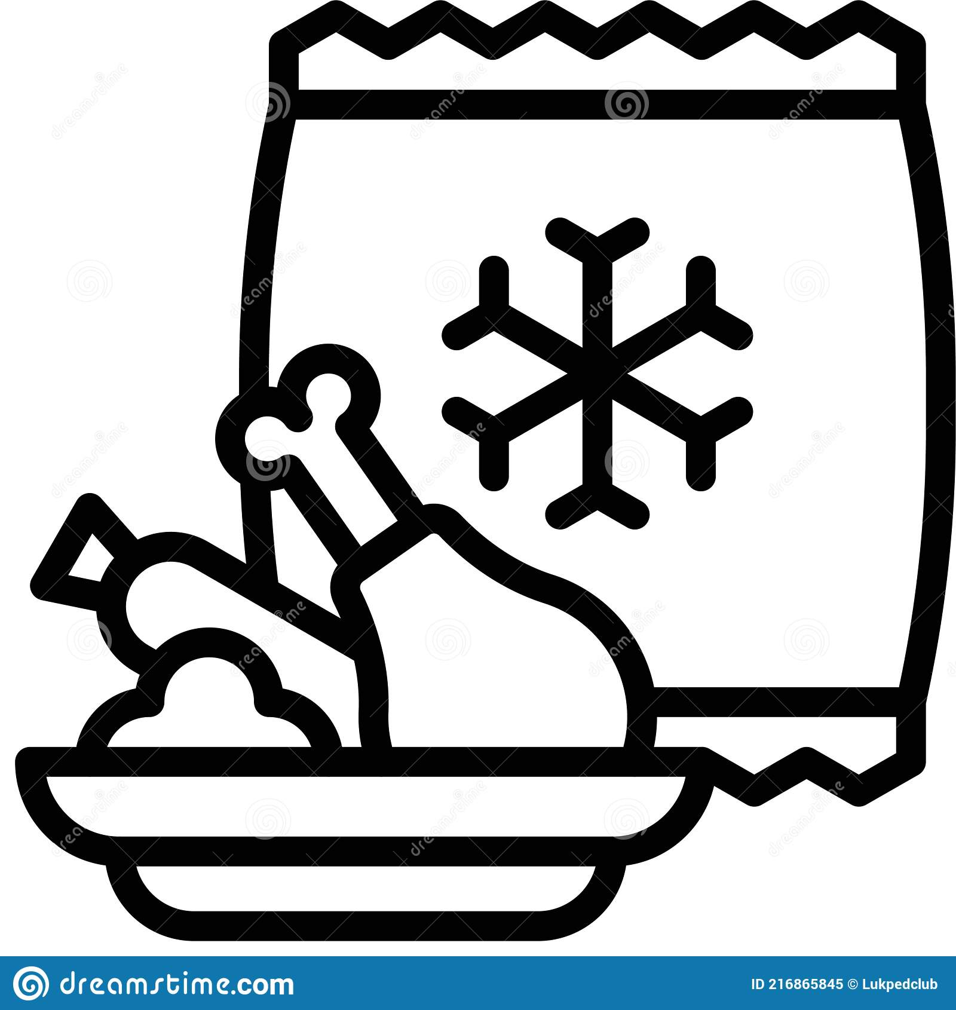
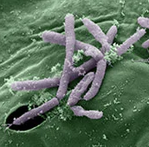


Applications
Frozen Foods
Snow-Making
Crystallization control
Theoretical Applications

